Slide 1
DADock Bootcamp for Developers
VCS Primer (with Git)
Service Technology Unit Field Engagement Div. Hiroaki Kobayashi

Slide 2
Training Introduction

Slide 3
Position in entire courses
01
Introduction Part
05
Automated Build Primer (with Gradle)
60min
60min
・Background
・DADock Introduction
・CI Introduction
・CD Introduction
06
Automated Unit Test Primer (with JUnit)
60min
02
Demonstration
(with DADock)
07
Automated Integ Test Primer (with Selenium)
60min
60min
Now Here!!
03
VCS Primer
(with Git)
08
Automated Deployment Primer (with Ansible)
60min
60min
04
CI/CD Pipeline Primer
(with GitLab)
09
Chat Primer (with Mattermost)
60min
60min
Notes:
ではイントロダクションパートを始めていきたいと思います。

Slide 4
Agenda
What’s Git
Merits of Git
Demo with Git

Slide 5
What’s Git?

Slide 6

What’s Git?
What’s Git?
Git is a Version Control System to manage
the version of resources(Code, document, etc)
change
merge
Repository
change
change

Slide 7
What’s Version Control?
What’s Git?
To manage the history of resources “When”, “Who”, “Where”, “Why” changed
9/19 16:30 uchiyama Initial Commit
9/19 16:35 hirakawa added XX
It’s also
available
to revert
to Specific
Version
change
merge
Repository
change
change
9/20 11:30 tsutsui changed YY

Slide 8
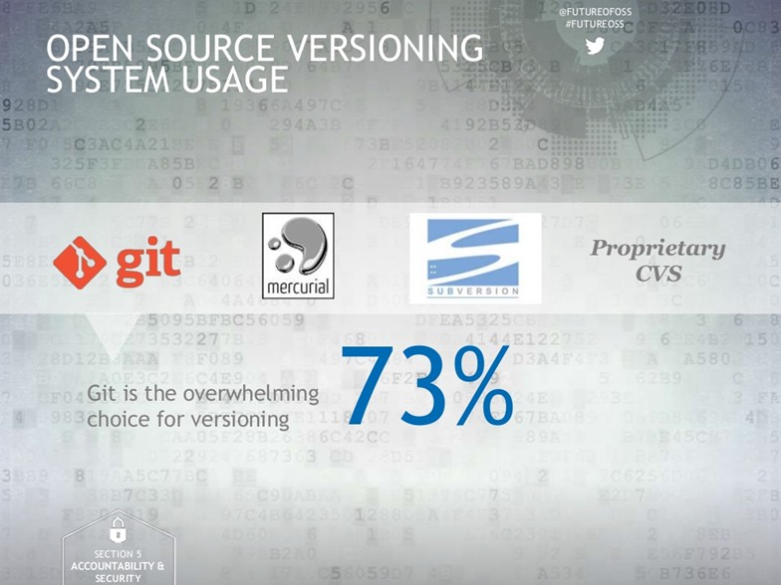
Trend of VCS tools
What’s Git?
https://www.slideshare.net/North_Bridge/2016-future-of-open-source-study-61431845

Slide 9
Git operation overview
What’s Git?
commit
To log modification
merge
To gather modification
Repository
branch
To branch the stream of history

Slide 10

Local Repository and Remote Repository
What’s Git?
Remote Repository
Platform Server
1. Get Latest
3. Refrect
Local Repository
Developer PC
2. Change Resource/Commit

Slide 11
Local Repository and Remote Repository
What’s Git?
Remote Repository
Pull
Get remote resources
To local
Push
Reflect local changes to remote
Local Repository

Slide 12
It’s possible to develop many members in same time
What’s Git?
Remote Repository
Get/Reflect Resources
Local Repository
It’s possible to log every member’s “When”, “Who”, “Where”, “Why”

Slide 13


Tools needed to be installed to use Git
What’s Git?
Install
or
or
・・・
GitHub
GitLab
Platform Server
Install
Git
Developer PC
※GitHub、GitLab ≠ Git

Slide 14
Recap : What’s Git
What’s Git?
Git：Version Control System for code, document, etc.
Version Control : To manage the history of resources “When”, “Who”, “Where”, “Why” changed
Git Operation :
Commit : To log the modification
Branch : To branch the stream of history
Merge： To gather modification
Pull : To get remote resources to local
Push : To reflect local changes to remote
Remote Repository = Server, Local Repository = Developers PC
GitHub/GitLab : Environment for remote repostiory
It’s possible to develop many members in same time

Slide 15
Merits of Git

Slide 16
Before Git
Merits of Git
Branch/Merge cost were high (main trunk base, branch only for bugfix)
Not feel free to commit, too many local resources
Need to think about other members’ modifications carefully
Local Resources(Not version controled)
Can’t commit until fixed
Log
Mr. Purple
Get
Log
History
Get
Get
If there’re other member’s
modifications,
It’s tough to merge
Merge Manually
Mr. Blue
Diff

Slide 17
Branch Based Development
Merits of Git
By branch based development, development with multiple members incredibly evolved
It become easy to develop without thinking about other members
merge
merge
Main Branch
Mr. A’s Branch
change
Mr. B’s Branch
change
change
Git is extremely good at branch development

Slide 18
Why Git is good at Branch Development?
Merits of Git
Easy Branch Control
Wise Automated Merge

Slide 19



1. Easy Branch Control
Merits of Git
In previous tools, it was required to connect with remote server to control branch -> Depends on environments it was too slow/not work
In Git, it is possible to control branch only with local repository -> no connection to remote, branch control is so fast
Connect only when to Reflect
Remote
Remote Repository
Connect
for each
operation
reflect
operation
Local Repository
Controlable only with local

Slide 20
2. Wise Automated Merge(same file)
Merits of Git
If the modified line was different, it’s possible to auto merge same file (If same line was modified, manual merge is needed)
Auto merge for same file
Change Line 1
Change Line 3

Slide 21
2. Wise Automated Merge(file trace)
Merits of Git
Previous tool’s merge can not trace file re-naming -> Can’t be merged automatically
Git is able to trace file re-naming -> It’s possible to auto merge
AAA.txt
???.txt
AAA.txt
BBB.txt
？
change
change
Repository
Repository
rename
rename
BBB.txt
BBB.txt

Slide 22
Recap : Merits of Git
Merits of Git
Before Branch Development -> It is needed to other member’s modification
After Branch Development -> The efficiency of multi member development improved
Why Git is good at Branch Development?
Easy to control branch -> Easy branch control
Wise automated Merge -> Easy branch merge

Slide 23
Demonstration

Slide 24
Story
Develop Parallel
Demonstration
index.html
index
.html
style
.css
index.html
index.html
index
.html
style
.css
Auto Merged
Develop Parallel

Slide 25
Go off the track…

Slide 26
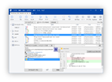
Operate Git easily!!
Demonstration
Using Git originally
>git add
>git commit
Hard to use unfamiliar commands…
C:\_
Operate
For Buginners
Using Git via GUI tools
Click Commit button!!
Easily Operate Git!!
Operate

Slide 27

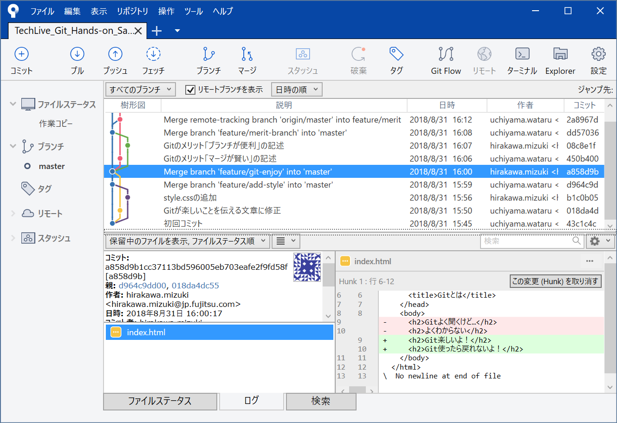
Recommend GUI Tool
Demonstration
Operate Git By Button
Visualize History
Point out Changed Lines

Slide 28
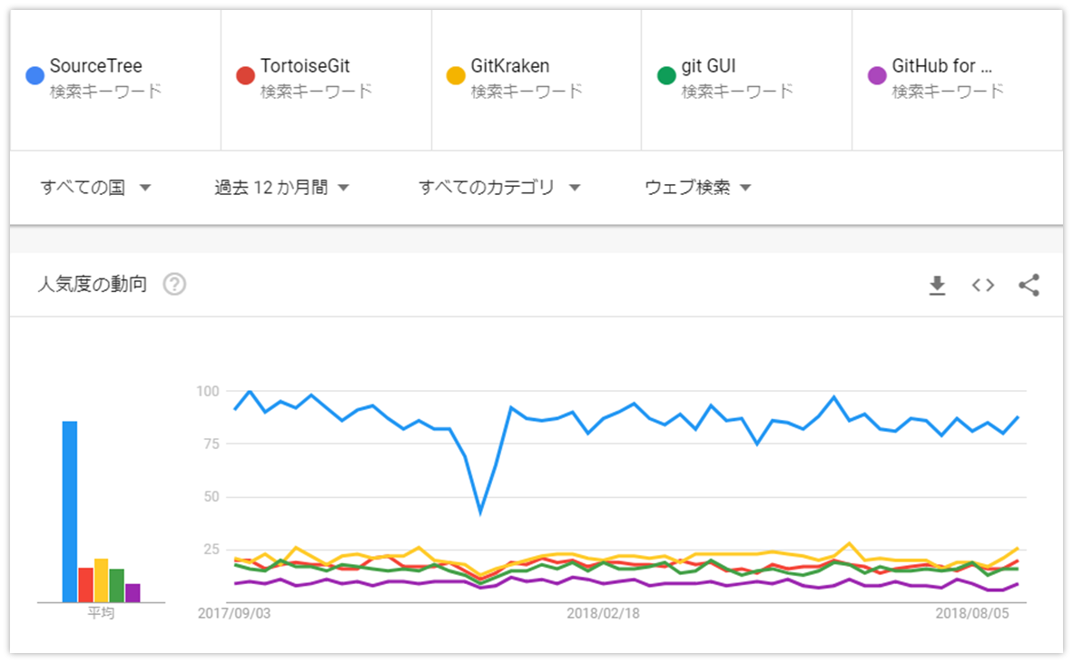
Recommend GUI Tool
Demonstration
The most popular Git Client in the world!!

Slide 29

Preparation for Demo
Demonstration
Installed in Platform Server
GitLab
Installed for each PC
and
Git
SourceTree

Slide 30
Today’s Initial Resource
Demonstration
index.html
<!DOCTYPE html>
<html lang="ja">
<head>
<meta charset="UTF-8">
<title>What’s Git</title>
</head>
<body>
<h2>Often hear Git. but…</h2>
<h2>Don’t know well</h2>
</body>
</html>
index.html
index
.html
style
.css
index.html
index.html
index
.html
style
.css
Sample：http://gitlab.trial.dadock.dat.css.fujitsu.com/pages/VCSPrimer-withGit

Slide 31
Today’s Initial Resource
Demonstration
index.html
<!DOCTYPE html>
<html lang="ja">
<head>
<meta charset="UTF-8">
<title>What’s Git</title>
</head>
<body>
<h2>Often hear Git. but…</h2>
<h2>Don’t know well</h2>
</body>
</html>
index.html
index
.html
style
.css
index.html
index.html
index
.html
style
.css
Sample：http://gitlab.trial.dadock.dat.css.fujitsu.com/pages/VCSPrimer-withGit

Slide 32
Ref : Let’s Prepare remote repo and initial rsc
Demonstration
Create Project(Remote Repository)
Ref : https://docs.gitlab.com/ee/gitlab-basics/create-project.html
Clone Repository
Clone : To copy Remote Repository toward local
Ref：https://backlog.com/ja/git-tutorial/intro/intro3_2.html
Create initial resource on local and commit & push
Comit & Push operations will be shown in following demo!!

Slide 33
Demonstration 1
Edit your resource in Local

Slide 34
Demo 1: Edit your resource in Local
Demonstration1
Tsutsui-san
Develop in Parallel
index.html
index
.html
style
.css
index.html
index.html
index
.html
style
.css
Merged Wisely
Develop in Parallel
Uchiyama-san

Slide 35
Demo 1: Implementation for Uchiyama-san(1/2)
Demonstration1
style.css
（Crate New File）
h1 {
color: rgb(255, 0, 0);
}
h2 {
color: rgb(51, 102, 153);
}
body {
margin: 2em;
}
* {
font-family: Arial, Helvetica, sans-serif;
}

Slide 36
Demo 1: Implementation for Uchiyama-san(2/2)
Demonstration1
index.html
（Add description to read CSS）
<!DOCTYPE html>
<html lang="ja">
<head>
<meta charset="UTF-8"> <link rel="stylesheet" type="text/css" href="style.css">
<title>What’s Git</title>
</head>
<body>
<h2>Often hear Git. but…</h2>
<h2>Don’t know well</h2>
</body>
</html>

Slide 37
Demo 1: Implementation for Tsutsui-san
Demonstration1
index.html
（Edit Text)
<!DOCTYPE html>
<html lang="ja">
<head>
<meta charset="UTF-8">
<title>What’s Git</title>
</head>
<body>
<h2>Git is exciting!!</h2>
<h2>Can’t go back to other tools!!</h2>
</body>
</html>

Slide 38
Branch rule for this Demo
Demonstration1
master branch：branch to keep working codes （Correctly work coeds must be merged）
master
feature branch：branch to develop new features
feature/edit-text (Tsutsui-san)
feature/add-style (Uchiyama-san)

Slide 39
Demo 1: Edit your resource in Local
Demonstration1
master
branch
feature
branch
index.html
pull
index.html
style.css
push
branch
commit
master
branch
Uchiyama-san
feature
branch
index.html
develop
index.html
style.css

Slide 40
Demo 1: Edit your resource in Local
Demonstration1
Tsutsui-san
Develop in Parallel
index.html
index
.html
style
.css
index.html
index.html
Demo Time!!
index
.html
style
.css
Merged Wisely
Develop in Parallel
Uchiyama-san

Slide 41
Ref: Logs by commit
Demonstration1
Why
When
Who
Where

Slide 42
Demonstration 2
Review & Merge Code!!

Slide 43
Demo 2: Review and Merge Code!!
Demonstration2
Tsutsuiさん
index.html
index
.html
style
.css
index.html
index.html
index
.html
style
.css
Auto Merged
Uchiyamaさん

Slide 44
Let’s review before merge
Demonstration2
Case : merged without reviewing by anyone...
merge
Code not satisfy purpose
implement
Bug

Slide 45
Let’s review before merge
Demonstration2
Case : merged with reviewing
Prevent Problems
merge
implement
No Problem!
Reviewer
Ask to revise

Slide 46
Let’s review before merge
Demonstration2
Merge Request*:
Enables to ask
「Please review & merge it」
Reviewee
Reviewer
merge
implement
No Problem!
Reviewer
Ask to revise
* The same feature is called “Pull Request” in GitHub

Slide 47
Flow from Merge Request -> Merge
Demonstration2
* Other members can participate with reviewing
1. Create Merge Request
2. Review
3. Revise Code
4. Approve Merge

Slide 48
Flow from Merge Request -> Merge
Demonstration2
index.html
index
.html
style
.css
index.html
index.html
Demo Time!!
index
.html
style
.css
Auto Merged
Uchiyamaさん

Slide 49
Confirm whether rightly merged
Demonstration2
（master branch after merged）
index.html
style.css
← File created by Uchiyama-san is added
index.html
style.css
<!DOCTYPE html>
<html lang="ja">
<head>
<meta charset="UTF-8">
<link rel=“stylesheet” type= “text/css“ href="style.css">
<title>What’s Git?</title>
</head>
<body>
<h2>Git is exciting!!</h2>
<h2>Can’t go back to other tools!!</h2>
</body>
</html>
h1 {
color: rgb(255, 0, 0);
}
h2 {
color: rgb(51, 102, 153);
}
body {
margin: 2em;
}
* {
font-family: Arial, Helvetica, sans-serif;
}

Slide 50
Demonstration 3
Resolve Conflict!!

Slide 51
What’s conflict?
Demonstration3
Conflict occurs when SAME LINE is modified separately.
Git cannot decide which modification to use automatically (need to be decided manually)
Case Conflict not occur
Case Conflict occur
Merged
Conflict!!

Slide 52
Let’s occur conflict
Demonstration3
Add
Add
Tsutsui-san
New Branch
Uchiyama-san
New Branch
index.html
index.html
<!DOCTYPE html>
<html lang="ja">
<head>
<meta charset="UTF-8">
<link rel=“stylesheet” type= “text/css“ href="style.css">
<title>What’s Git?</title>
</head>
<body>
<h2>Git is exciting!!</h2>
<h2>Can’t go back to other tools!!</h2>
<h1>Auto Merge is wise</h1>
</body> </html>
<!DOCTYPE html>
<html lang="ja">
<head>
<meta charset="UTF-8">
<link rel=“stylesheet” type= “text/css“ href="style.css">
<title>Gitとは</title>
</head>
<body>
<h2>Git is exciting!!</h2>
<h2>Can’t go back to other tools!!</h2>
<br/> <h1>Branch is useful</h1> </body> </html>

Slide 53
Flow to solve conflict
Demonstration3
0. Conflict!!
master
3. Merge
Review & merge using Merge Request
feature
1. Make conflict happen in Local
（It’s not scary in Local）
2. Solve Conflict
Decide which modification to use manually
master
feature

Slide 54
How to solve conflict?
Demonstration3
master
Local Repository
feature
When we make conflict happen in local…
index.html
index.html
<body>
<h2>Git is exciting!!</h2>
<h2>Can’t go back to other tools!!</h2>
<<<<<<< HEAD
<br/> <h1>Branch is useful!! </h1>
=======
<h1>Auto Merge is wise!!</h1> >>>>>>> master
</body> </html>
<body>
<h2>Git is exciting!!</h2>
<h2>Can’t go back to other tools!!</h2>
<br/> <h1>Branch is useful!!</h1>
<h1>Auto Merge is wise!!</h1>
</body> </html>
For this time, use both lines
Mark as above is added automatically
Delete Unnecessary code & marks & commit

Slide 55
Ref : How to PREVENT conflict
Demonstration3
It’s important to create a RULE to decrease conflict
e.g. Don’t allow to edit same file, same line
e.g. Commit/Merge to master in short span (It tends to conflict if the master branch glow big)
Etc.
But it’s not possible to avoid conflict perfectly
Every develop member should learn how to SOLVE conflict

Slide 56
Recap for demo 1~3
Demonstration3
Demo1
Demo2
Demo3
Edit
Review & Merge
Resolve Conflict
index.html
index.html
index
.html
index
.html
style
.css
index.html
index.html
index.html
index
.html
style
.css
index
.html
index
.html

Slide 57
Omake: other useful commands
Demonstration3
checkout
Move to specified commit or branch, tag, etc.
fetch
Check the latest status of remote repository
stash
Shunt the un-committed files temporally
Clone
Copy remote repository and create local repository

Slide 58
Notes for starting Git

Slide 59
In this course we used two kinds of branch
Notes for starting Git
master branch：branch to keep working codes （Correctly work coeds must be merged）
master
feature branch：branch to develop new features
feature/edit-text (Tsutsui-san)
feature/add-style (Uchiyama-san)

Slide 60
De-merit of this branch strategy
Can share edited resource after merged to main branch…
Notes for starting Git
If many members develop in same time…
master
feature
Feel anxious
whether it works or not
after merged to main trunk
feature
feature
・・・
・・・
feature
-> In some case, it will cause merge delay

Slide 61
Sample for this team : use develop branch
Notes for starting Git
develop branch: To share members works in daily
Not merge to master
-> Feel free to share
master
develop
Able to confirm to run with latest code
feature
feature
feature
Psychological
barrier to merge is lower
・・・
・・・
feature

Slide 62
No almighty answer for Git Branch Strategy
= Need to find out the suitable way for your team

Slide 63
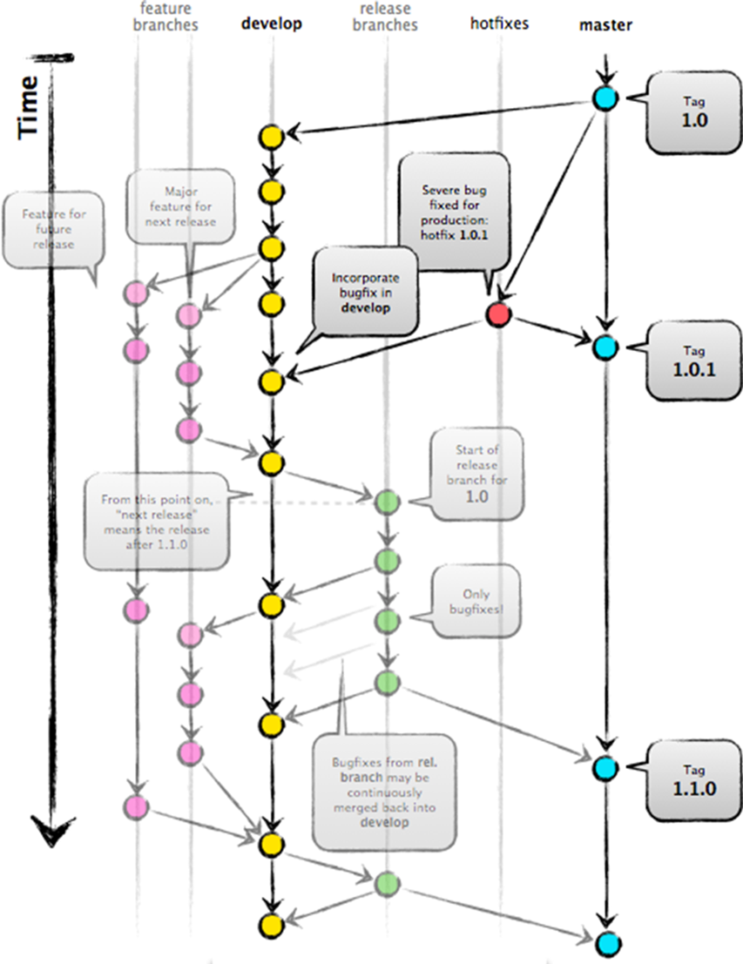
Famous Branch Strategy : git-flow for big project
Notes for starting Git

Slide 64

Famous Branch Strategy : GitHub Flow speedy
Notes for starting Git
Merge Request
feature
Implement
modify
modify
merge
merge
master
feature
Merge Request
modify
modify
This demo was operated under GitHub Flow!!

Slide 65
Important things for branch design
Notes for starting Git
To decide the purpose for each branch
Why/How to use branch?
To decide the rule for each branch
From where/To where to branch/merge
Design permission for branch
Review the branch strategy in according to team situation
e.g. Added qa branch for the query from QA team
e.g. Deleted develop branch because of that the communication among developers has improved
There are NO almighty strategy which fit to ALL team

Slide 66
Last and not the Least
We are happy, if we could lower the barier for using Git.
The most fast way to learn Git is “TO USE IT by your self”.
Please practice again and again referring demo sample codes.
Thanks for Listening!!

Slide 67
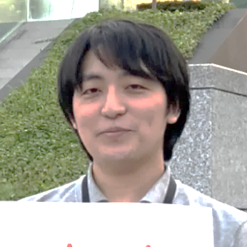
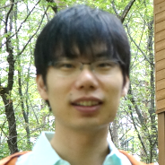

Special Thanks for the Course Developers!!
Connected Service Tech Div/STU/Fujitsu Japan
Mizuki Hirakawa
Development Navigation Service/FSWeb
Joji Tsutsui
Development Navigation Service/FSWeb
Wataru Uchiyama

Slide 68
These excellent colleagues are in Wadatsumi
http://mattermost.wadatsumi.dat.css.fujitsu.com/wadatsumi/channels/devops_git-learning

